Slide 1
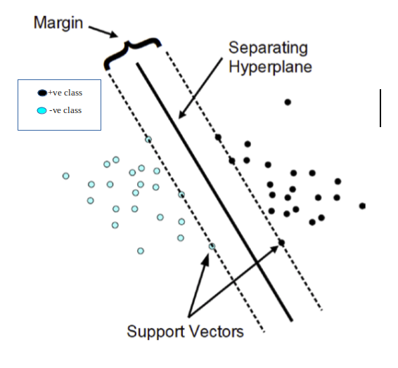
Tutorial 5
﻿CS5486 Intelligent Systems:
Radial Basis Function Neural Network
and Support Vector Machine
Hongzong Li
Department of Computer Science City University of Hong Kong

Slide 2
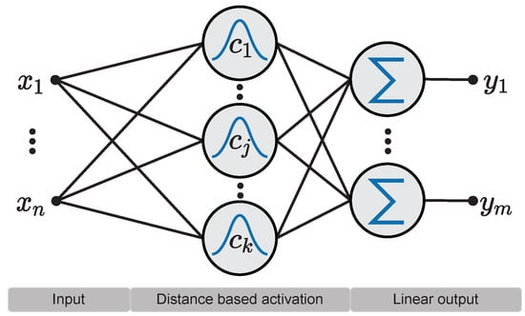
Radial Basis Function (RBF) Neural Networks
Radial Basis Function (RBF) Neural Networks are a specialized type of Artificial Neural Network (ANN) used primarily for function approximation tasks.
Three-layer architecture
Notes:
RBF network in its simplest form is a three-layer feedforward neural network. The first layer corresponds to the inputs of the network, the second is a hidden layer consisting of a number of RBF non-linear activation units, and the last one corresponds to the final output of the network.
Activation functions in RBFNs are conventionally implemented as Gaussian functions. Here shows an example of the RBFN structure.

Slide 3
Radial Basis Function (RBF) Neural Networks
RBF and MLP belong to a class of neural networks called feed-forward networks.
What is the difference between RBF and MLP?
In RBF, each hidden unit act as a point in input space and activation/output for any instance depends on the distance between that point(Hidden Unit) and instance(a sample point)
RBF learns two kinds of parameters: 1) Centers and width of RBFs. 2) Weights to from linear combination of outputs obtained from hidden layer.
Notes:
RBF and MLP belong to a class of neural networks called feed-forward networks.
Hidden layer of RBF is different from MLP. It performs some computations. Each hidden unit act as a point in input space and activation/output for any instance depends on the distance between that point(Hidden Unit) and instance(Also a point in space).
Thus, RBF learns two kinds of parameters: 1) Centers and width of RBFs 2) Weights to from linear combination of outputs obtained from hidden layer

Slide 4


Radial Basis Function (RBF) Neural Networks
The output of the i-th activation function in the hidden layer of the network can be calculated based on the distance between the input pattern x and the center c_{i} as follows:

Slide 5

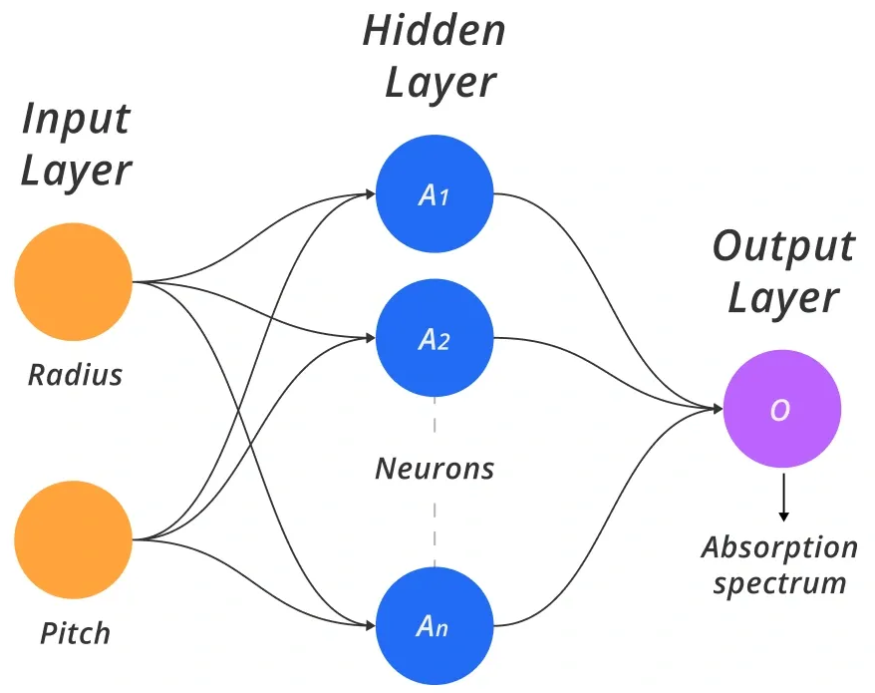
Radial Basis Function (RBF) Neural Networks
Then, the output of the node k of the output layer of the network can be calculated as follows:

Slide 6
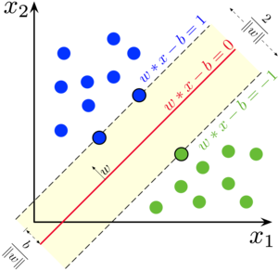
Support Vector Machine
Support Vector Machines (SVM) are powerful supervised learning algorithms widely used for classification and regression tasks.
SVM is a discriminative classifier that finds an optimal decision boundary (hyperplane) to separate different classes in a dataset. It works by maximizing the margin between data points of different classes.

Slide 7
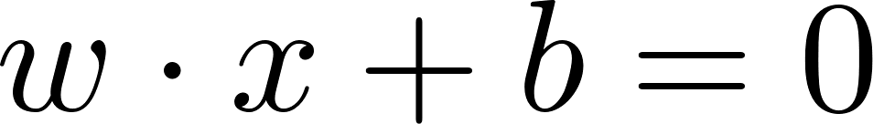
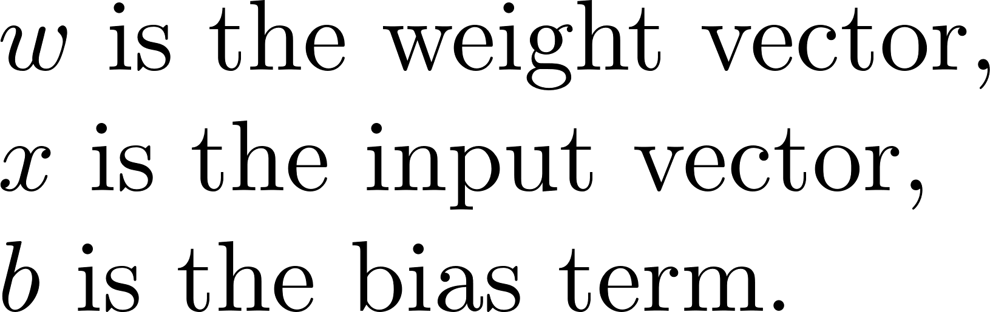
Support Vector Machine
Given a dataset with two classes, SVM finds a hyperplane that maximizes the margin.

Slide 8
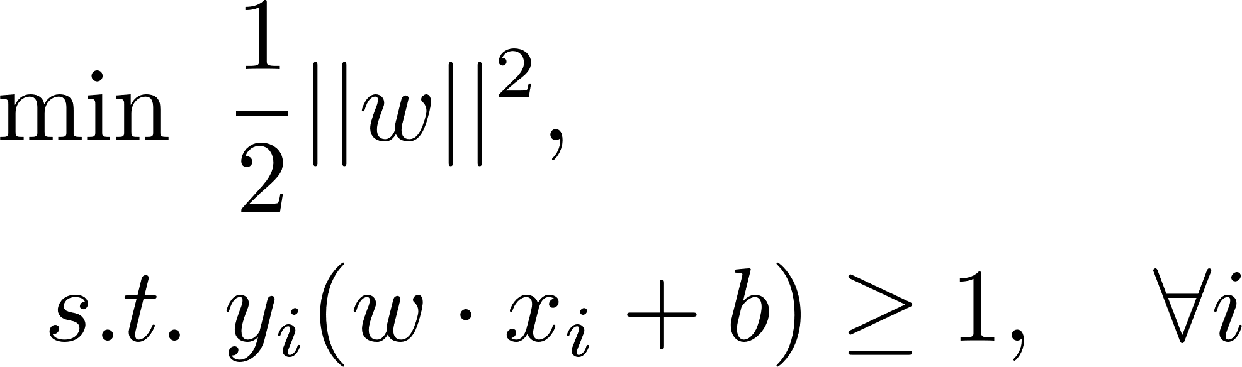
Support Vector Machine
Maximize the Margin
maximizes the margin
classification error

Slide 9
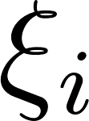
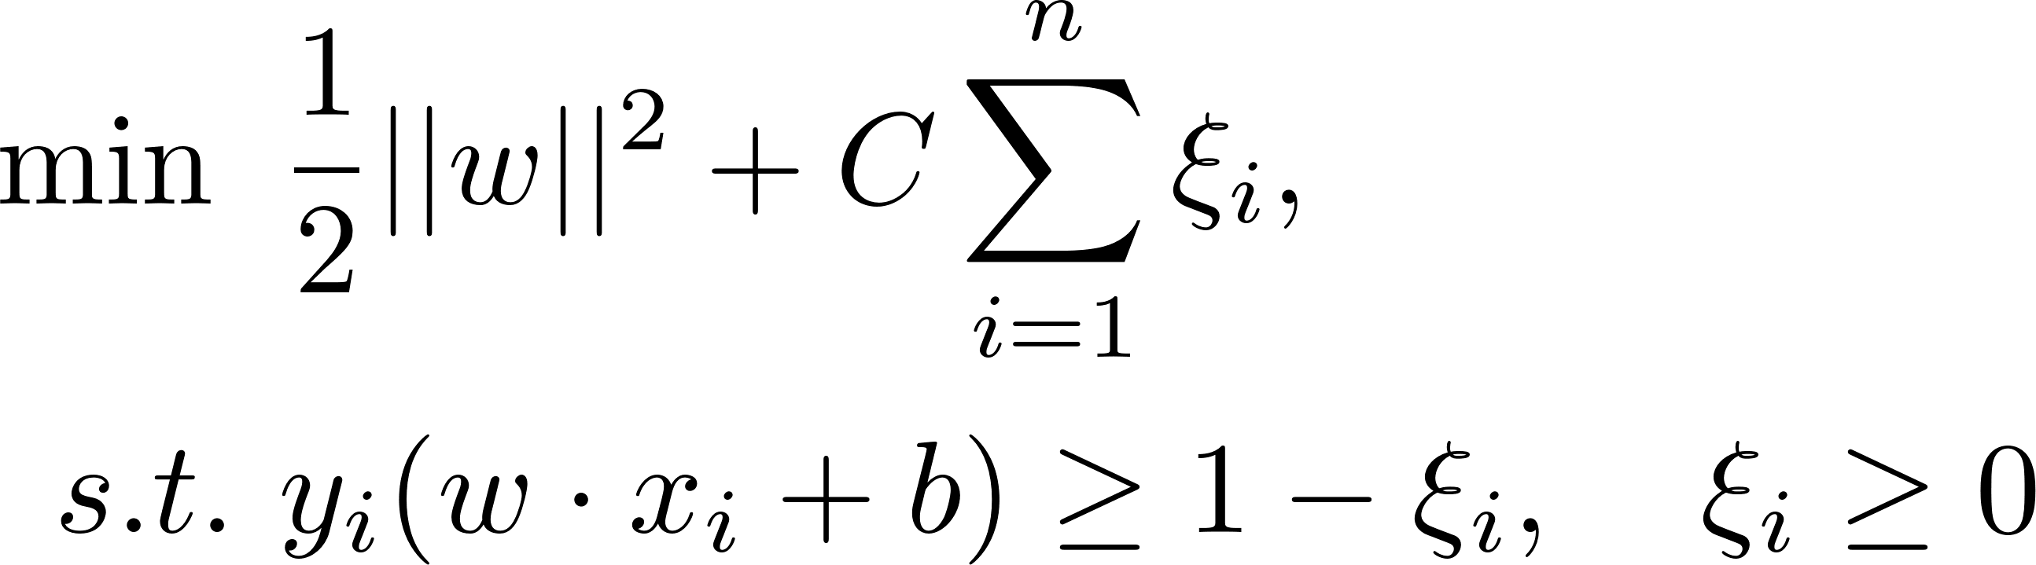
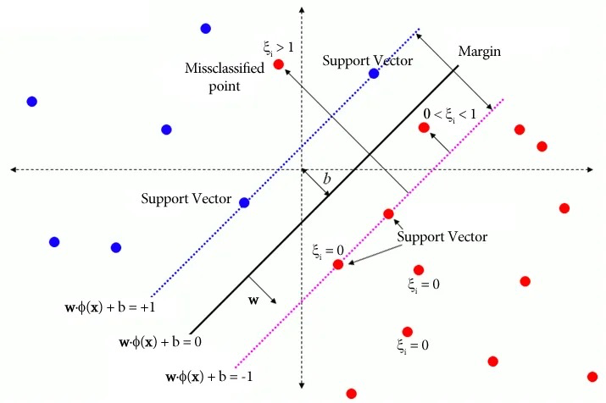
Support Vector Machine
Soft-Margin SVM (For Non-Separable Data)
introduce slack variables to allow some misclassifications:

Slide 10
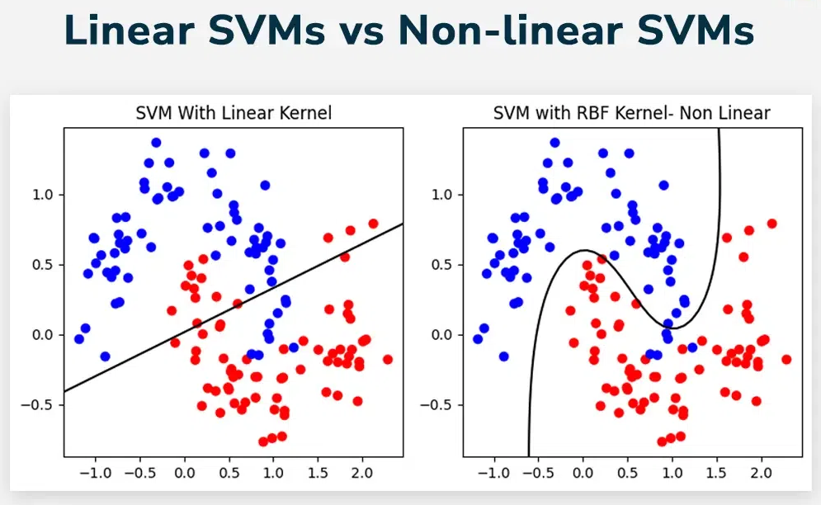
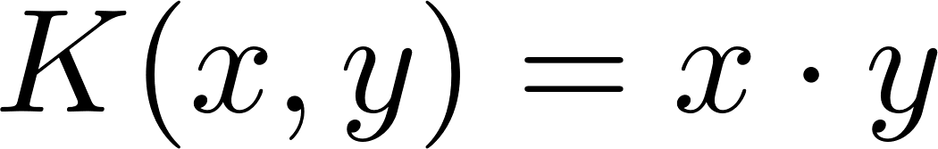
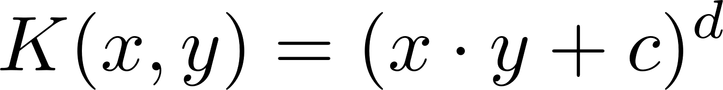
Support Vector Machine
When data is not linearly separable
Common Kernels:
Linear Kernel:
Polynomial Kernel:
Radial Basis Function (RBF) Kernel:
Sigmoid Kernel:
Notes:
If data is not linearly separable, SVM maps data into a higher-dimensional space using a kernel function \( K(x_i, x_j) \), which replaces the dot product:

Slide 11
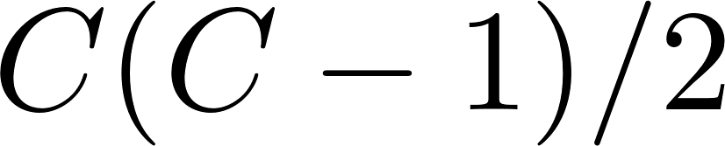
Support Vector Machine
Multi-Class Classification
1. One-vs-One (OvO)
Trains classifiers for C classes.
Each classifier is trained on a pair of classes.
The final prediction is determined using a voting mechanism.
2 One-vs-All (OvA)
Trains C classifiers for C classes.
Each classifier separates one class from all others.
The final prediction is made based on the highest decision score.

Slide 12
Thanks

